Slide 1
2024 GDE & AskO3
全球开发者大赛
Claro Peru ~ Battery App

Slide 2

作品信息 Submission Information
作品名称Presentation Name ：
Battery App
团队名称 Team Name： Mexico GNOC Tools team 1
团队成员 Team Member： Diana Laura Garcia Sanchez 00878630, EDGAR FRANCISCO ESTRADA VILLARREAL 00391141,Juan Abel Padilla Soria 00872446
区域 Region： Latin America
领域 Domain ：AMS
赛道/Track：GDE Track
申报奖项/Award：GDE Excellent Works Award
作品应用范围 Application Scope ：Management
作品应用主要项目Main Projects of Work Application ：Battery App

Slide 3
Overview of Battery App requirement
需求分析&背景介绍 Requirement analysis
The main requirement is to enhance the Battery App to accurately calculate battery autonomy and identify critical sites for optimized battery replacement strategies.

Slide 4
Key points
需求分析&背景介绍 Requirement analysis
Accurate Autonomy Calculation: Developing algorithms to calculate actual, complete, and partial battery autonomy based on specific alarm events and site conditions.
Critical Site Identification: Incorporating additional site attributes and developing a ranking algorithm to prioritize sites for battery replacement.
Improved Battery Replacement Strategy: Refining calculations for backup and recovery time, filtering out minor power outages, and implementing a notification system for critical battery issues.

Slide 5
业务挑战及痛点 Business Challenges and Pain Points
Inaccurate Battery Life Estimation:
Difficulty in accurately predicting battery life and remaining capacity.
Inefficient battery replacement planning, leading to unexpected outages.
Unoptimized Battery Replacement Strategy:
Lack of a clear prioritization mechanism for battery replacements.
Ineffective allocation of resources for battery maintenance and upgrades.
Suboptimal Network Uptime:
Frequent power outages and battery failures impacting network availability.
Decreased service quality and customer satisfaction.

Slide 6
业务挑战及痛点 Business Challenges and Pain Points
Inefficient Resource Utilization:
Inefficient utilization of battery resources, leading to unnecessary costs.
Suboptimal energy consumption and environmental impact.
Complex Data Analysis:
Difficulty in analyzing large volumes of network and battery performance data.
Inefficient identification of trends and patterns.

Slide 7
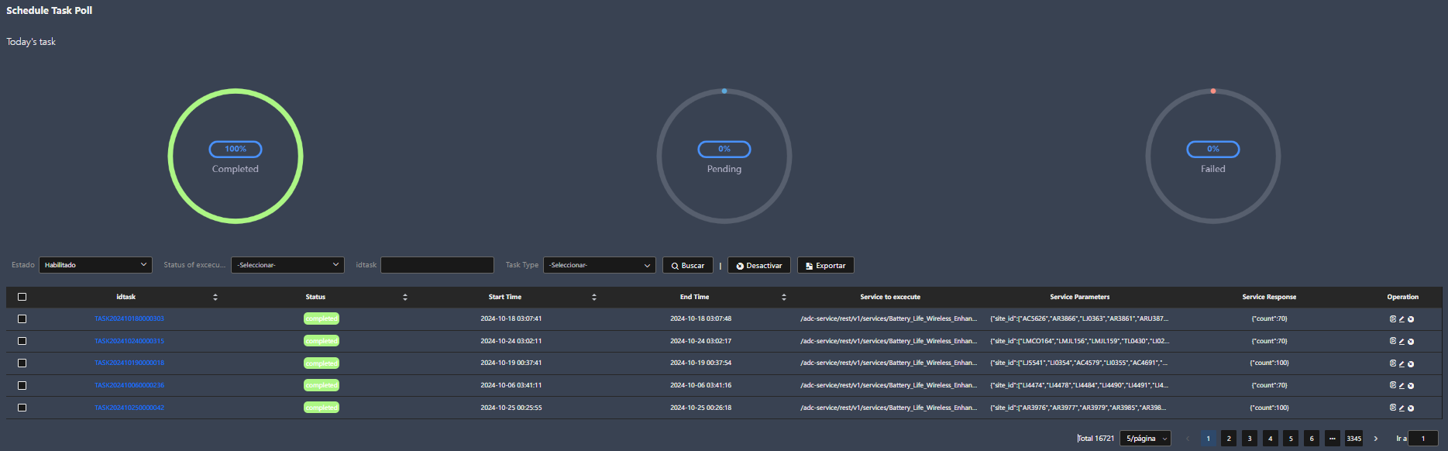
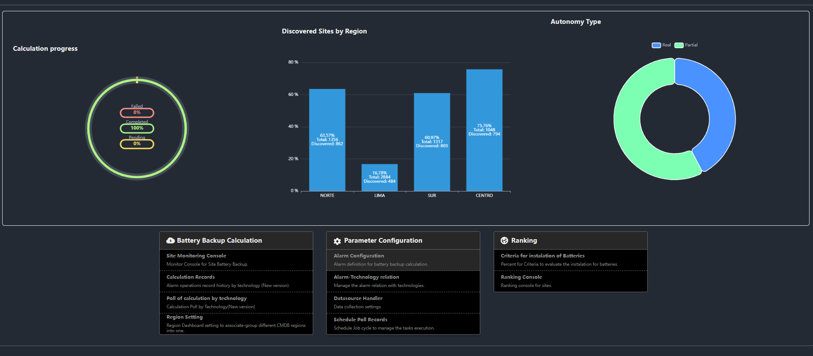
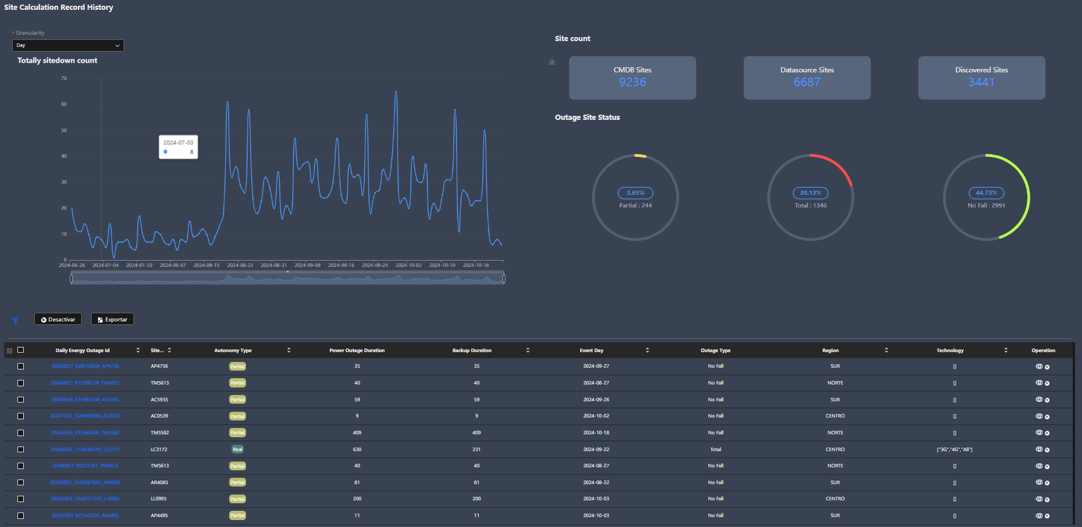
解决方案及作品介绍 Solution and product introduction
Power cut events
Trace the power cut events that affects the network
Customization
Match the battery backup calculation algorith according the business behavior
RESULTS
Monitoring views to get the network battery status

Slide 8
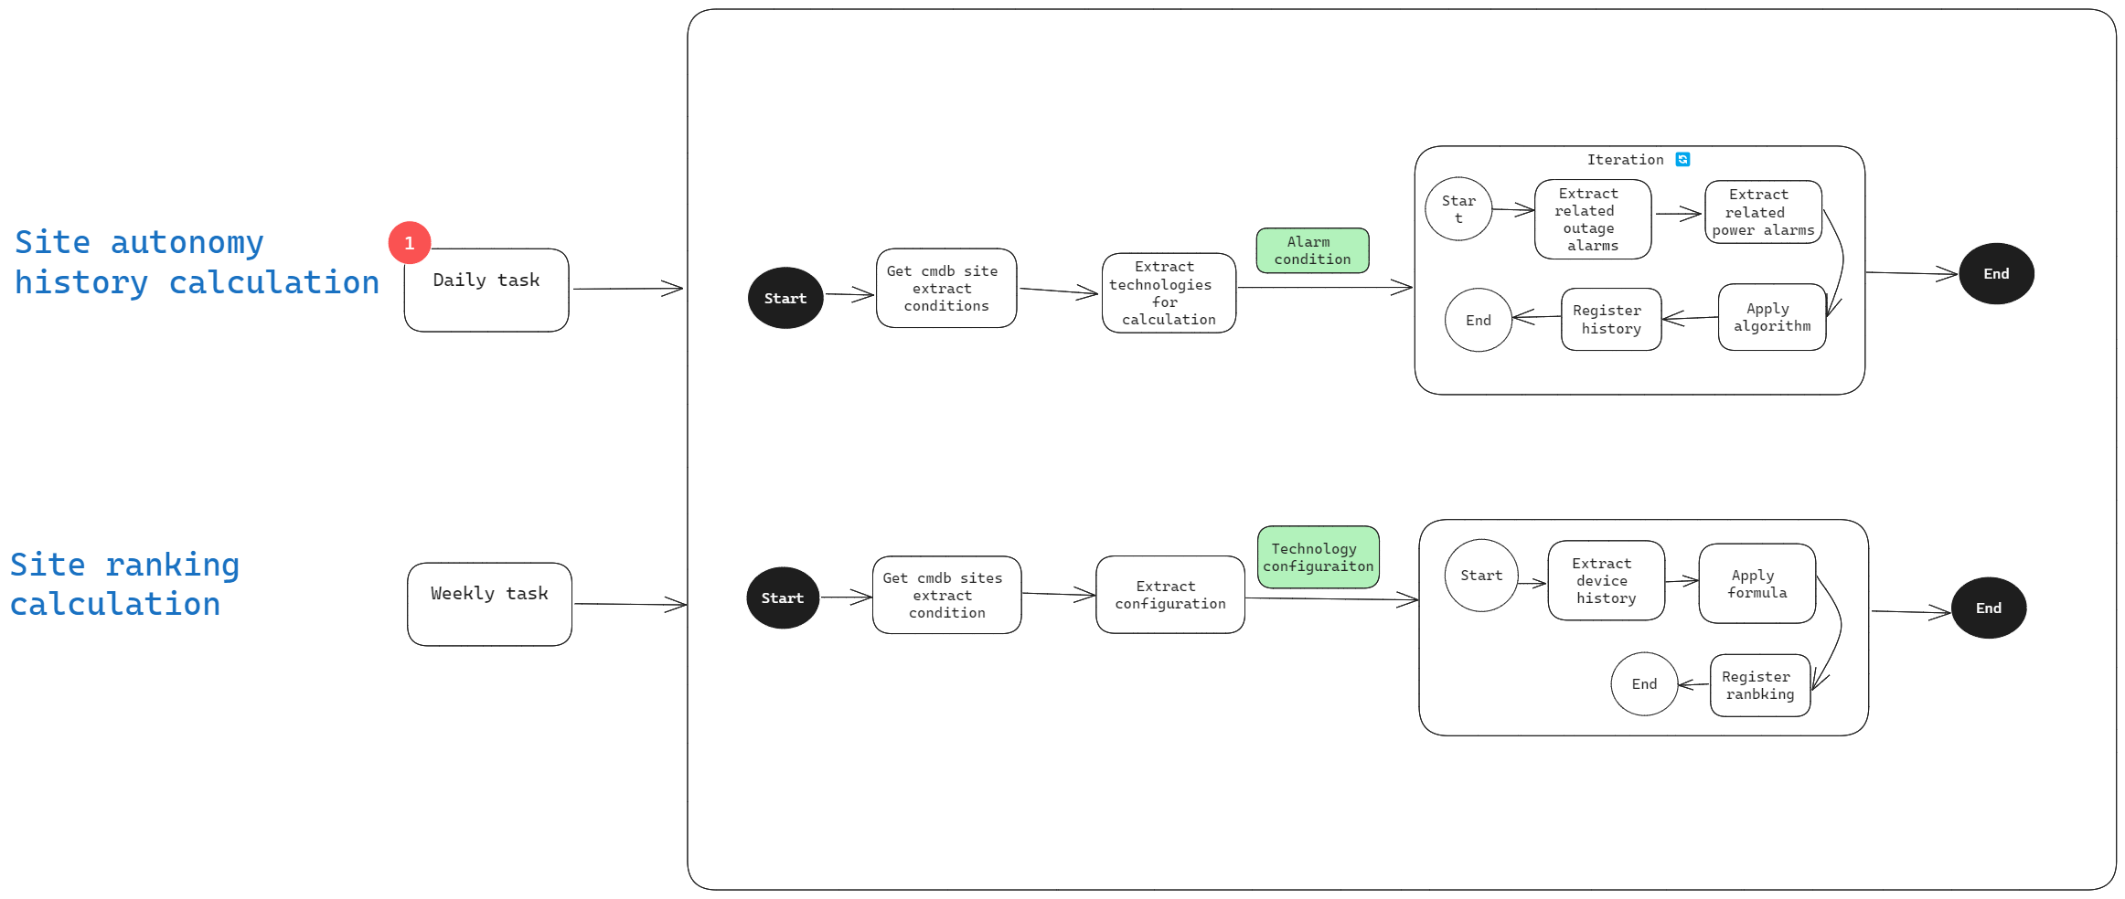
作品方案架构介绍 Introduction to the Scheme Architecture

Slide 9
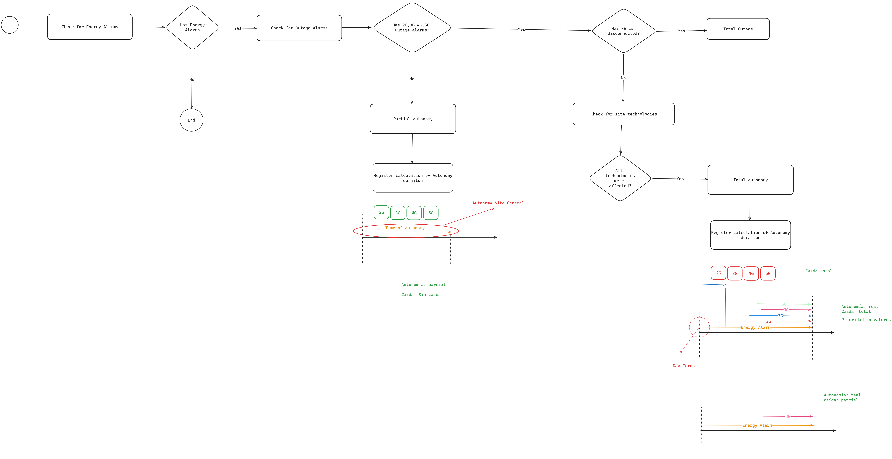
作品方案架构介绍 Introduction to the Scheme Architecture

Slide 10
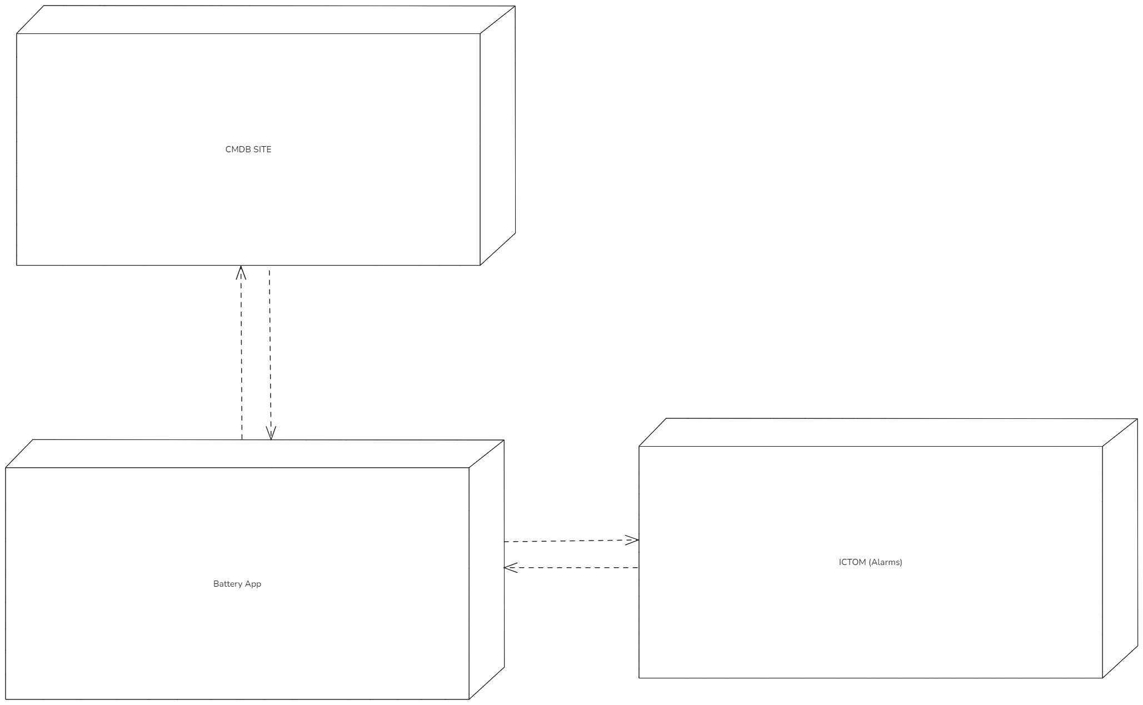
作品方案架构介绍 Introduction to the Scheme Architecture

Slide 11
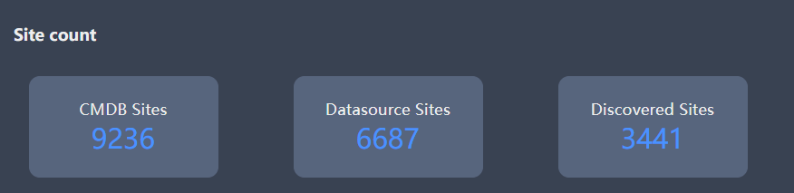
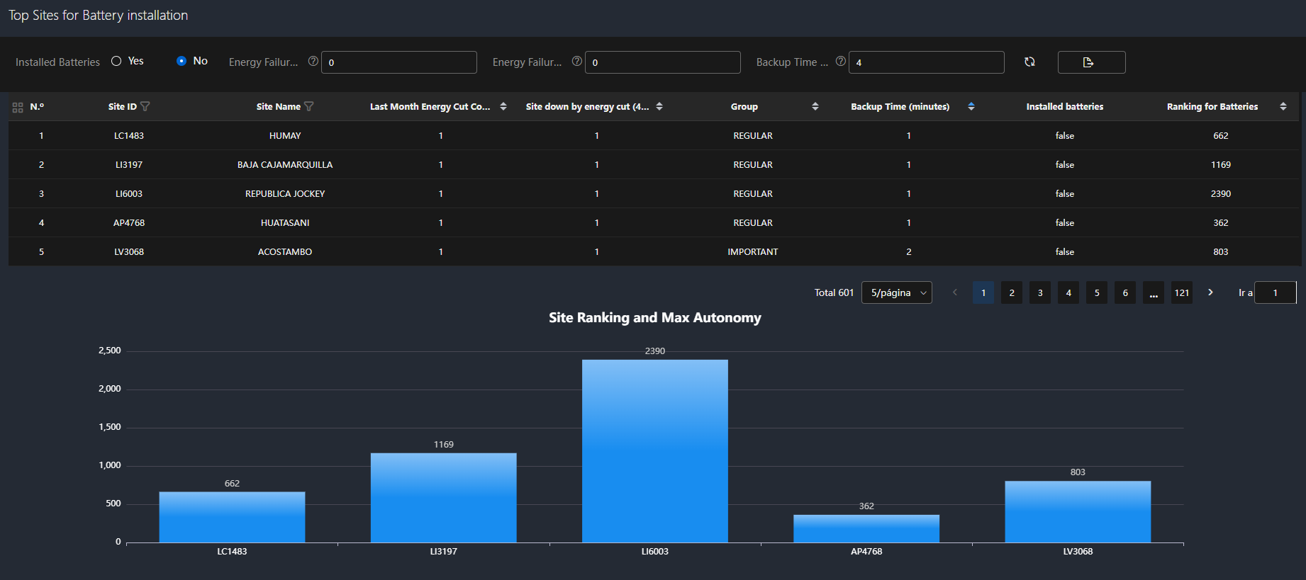
方案价值与收益 Solution Value and Revenue
By utilizing the algorithm-generated ranking list, customers can now make informed decisions about where to replace new batteries, prioritizing sites based on criticality and need.

Slide 12
THANK YOU！

